Slide 1
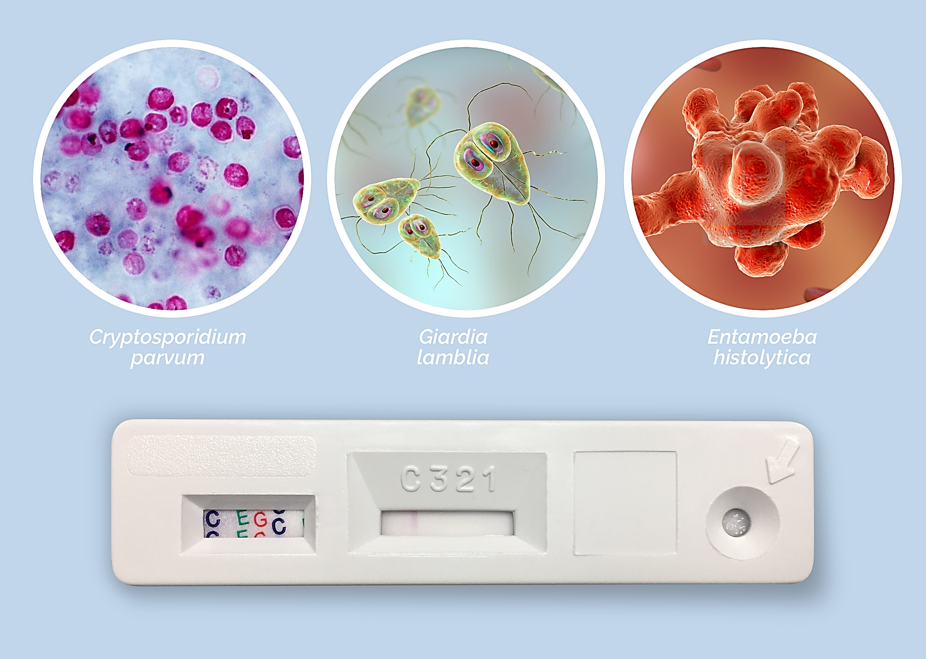
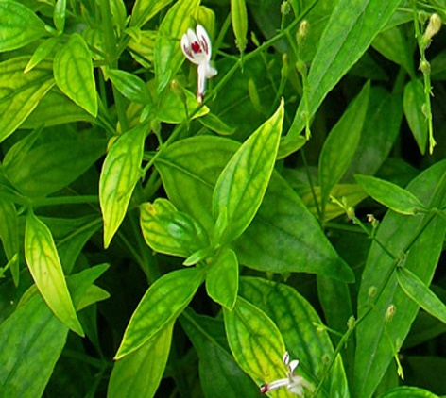
“Identification of a novel anti-parasitic compound from natural medicinal sources and their effect on Giardia lamblia”
Tapas Haldar, Ph.D.
Senior Researcher
Division of Parasitology
ICMR - National Institute for Research in Bacterial Infections

Slide 2
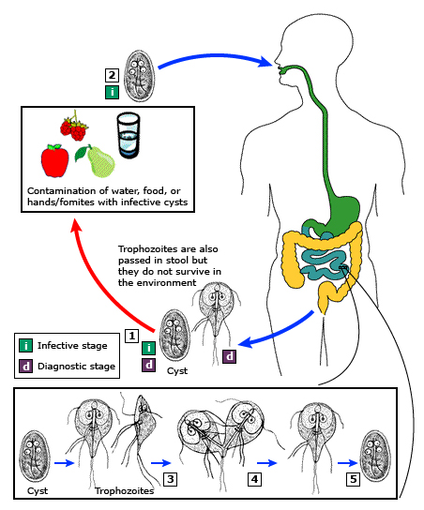
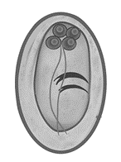
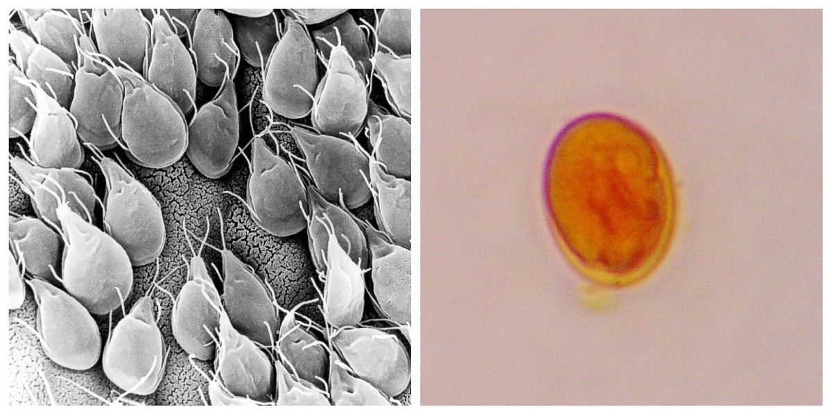
Introduction
Cyst
Trophozoites
Giardia different stages and life cycle.

Slide 3
Importance of Work
Global Burden: 280 million cases worldwide.
Prevalence: 2-5% in developed countries, 20-30% in developing countries.
Impact on Children: Increases the risk of malnutrition.
Drug Resistance: Metronidazole resistance is rising and refractory cases are reported.
Importance Traditional Medicine: Around 80% of people in Asia and Africa rely on medicinal plants for primary healthcare.

Slide 4
Work Plan
Study the Anti-giardial activity of Andrographis plant ethanoic extract in vitro
Dose kinetics.
Time kinetics.
Adherence properties.
Morphology study.
DNA Damage activity.
Cell Cycle inhibition.
Anti-giardial activity of Andrographolide in vitro
Dose kinetics.
Time kinetics.
Morphology Changes.
Cell Cycle inhibition.
DNA Damage activity.
ROS generation study.
Cloning and Expression of Cathepsin B
Primer design.
Selection of vector and Restriction enzyme.
Restriction Digestion.
Ligation.
Transformation.
Protein Expression.
SDS PAGE.
Western Blot.
Differential gene expression study after Andrographolide treatment
RNA Isolation.
cDNA preparation.
Real-Time PCR for Up and Down-regulation of pathogenic factor.
Cytotoxicity of Andrographolide in INT-407 intestinal cell line
Co-culture Establish.
Effect of Andrographolide on intestinal cells.
Effect of Andrographolide on Giardia Co-culture.
Anti-giardial activity of Andrographolide in vivo
Establish infection.
in vivo study of andrographolide in mice model.

Slide 5
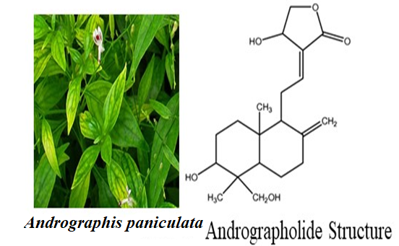
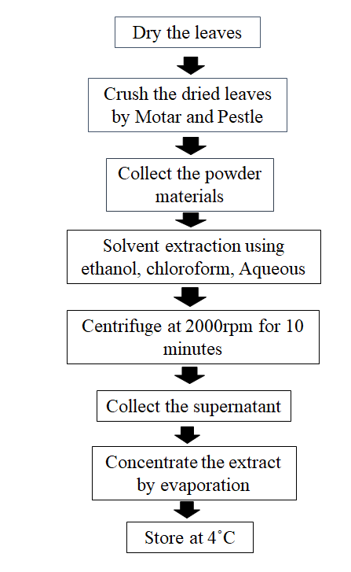
Plant selection and extract preparation
Plant extract preparation
Selected Plant: Andrographis paniculata
Active compound: Andrographolide.

Slide 6
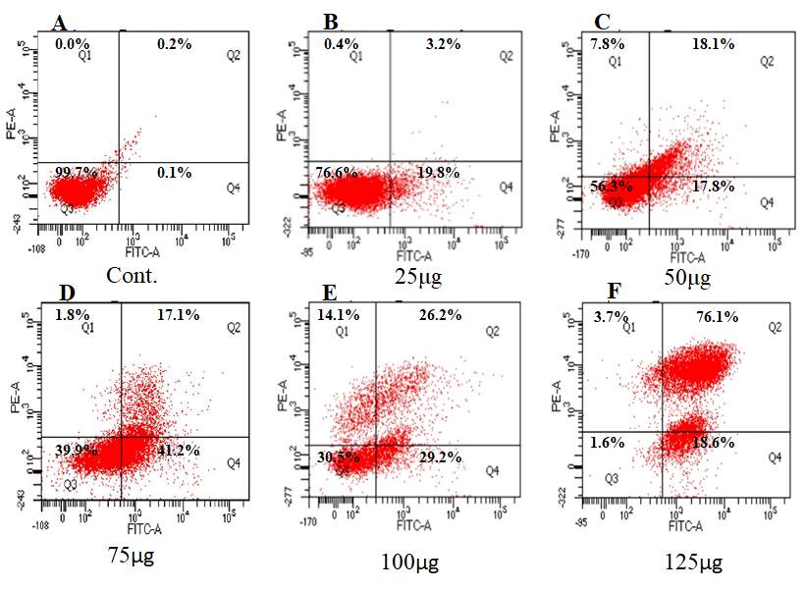
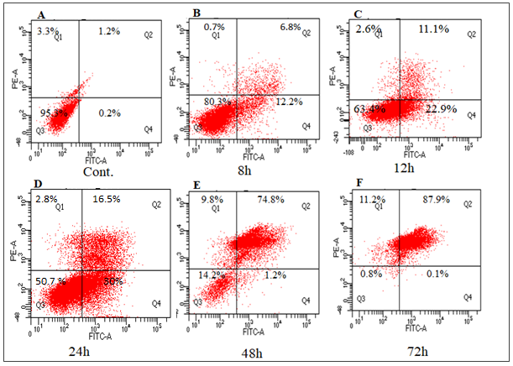
Effect of Ap extract on Giardia trophozoites
The figure depicts the results of a flow cytometry analysis of cells that were stained with FITC-PI and treated with Ap extract. The cells were categorized based on their response to treatment, with quadrant Q1- necrotic cells, quadrant Q2- late apoptotic cells, quadrant Q3- living cells, and quadrant Q4- early apoptotic cells.
Cell death activity of Giardia trophozoites after treatment with Ap extract at different doses & Time kinetics.

Slide 7
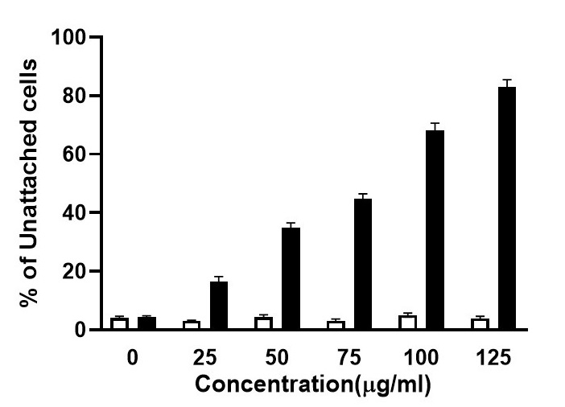
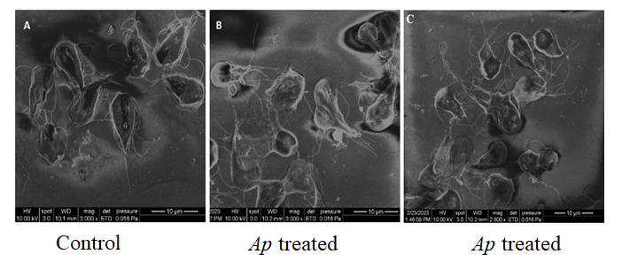
Effect of Ap extract on Attachment and Morphology changes
Inhibition of Cell Attachment
Trophozoites morphology changes
Ap extract induces alterations in trophozoite morphology and inhibits cell attachment.

Slide 8
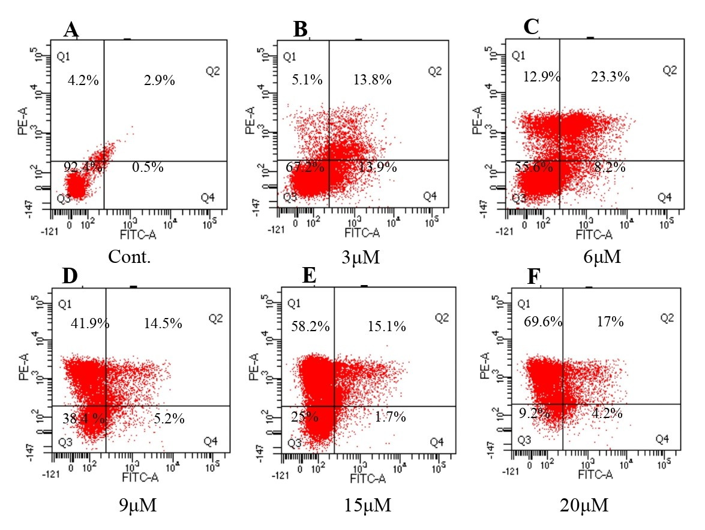
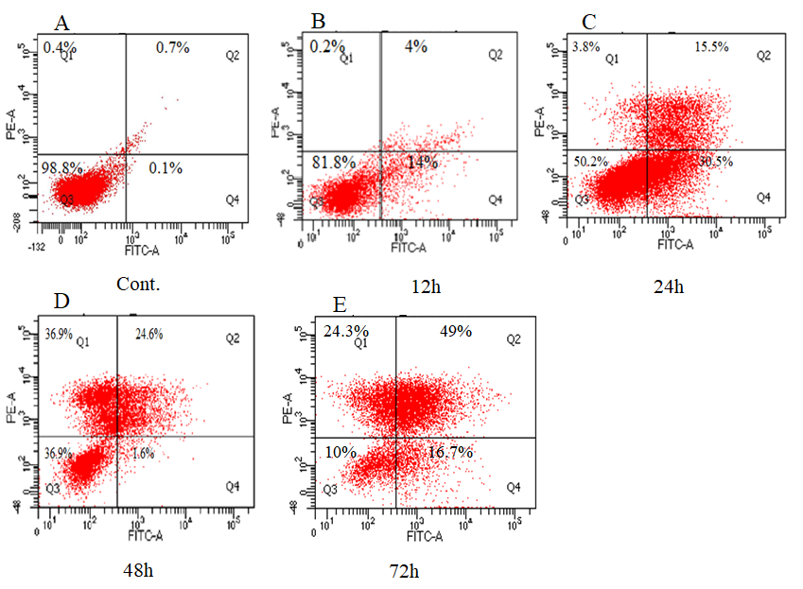
Cytotoxic activity of Andrographolide (Active compound of Ap plant)
Cell death activity of ADG at different doses after 24 hours.
Cell death activity of ADG in different time intervals.

Slide 9
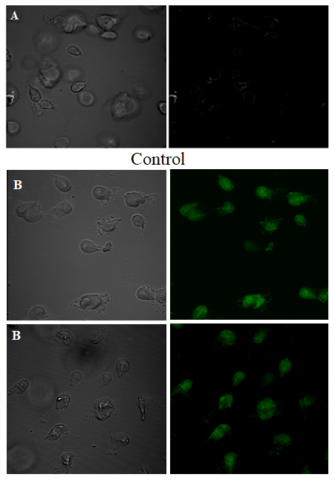
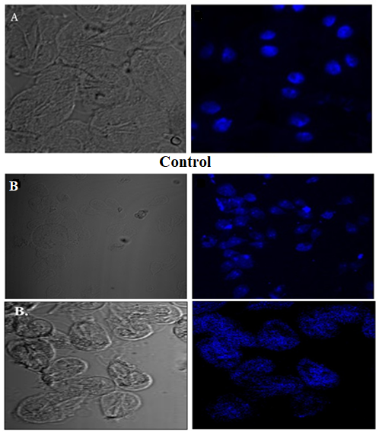
Andrographolide causes ROS Generation and Nuclear Damage
ADG treated
ADG treated
ADG induces excessive ROS generation and nuclear degradation in giardia trophozoites.

Slide 10
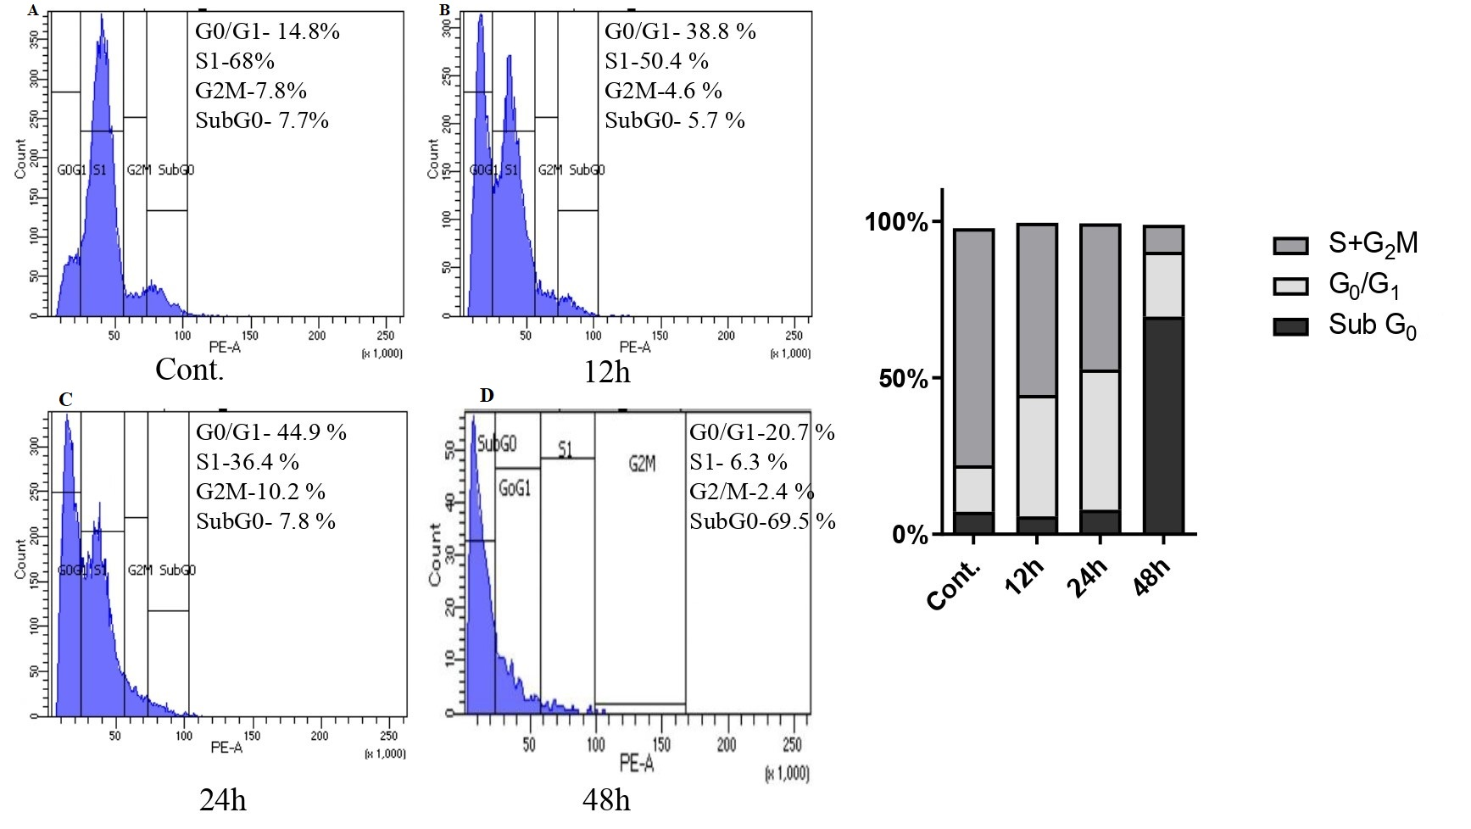
Andrographolide arrest Giardia Cell Cycle !!
Andrographolide induces cell cycle arrest in Giardia

Slide 11
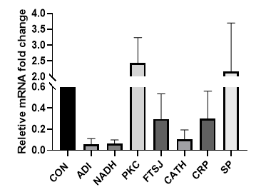
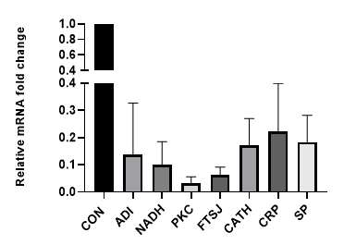
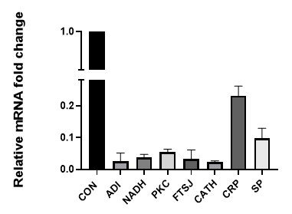
Gene expression changes after ADG treatment
3μM
9μM
20μM
Changes in gene expression at different doses following treatment with ADG.

Slide 12
Gene expression changes after ADG treatment
Changes in gene expression at various time intervals following treatment with ADG.

Slide 13
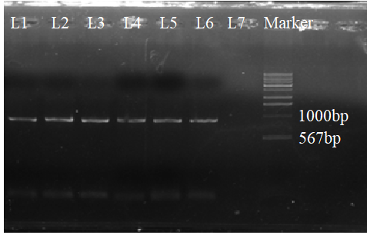
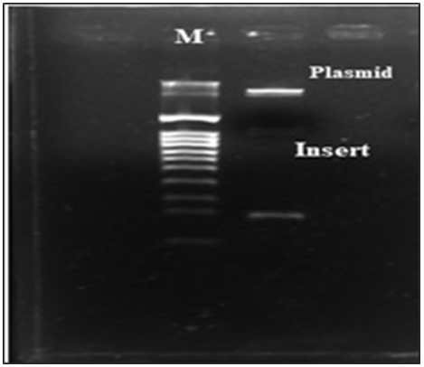
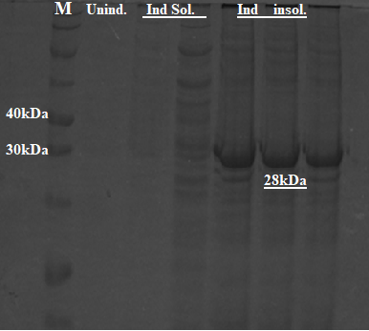
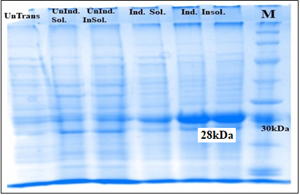
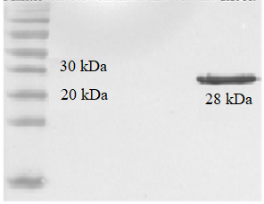
Cloning and Antibody Generation of Cathepsin-B gene
Colony PCR Restriction digestion
SDS-PAGE of Cathepsin B
Western Blot

Slide 14
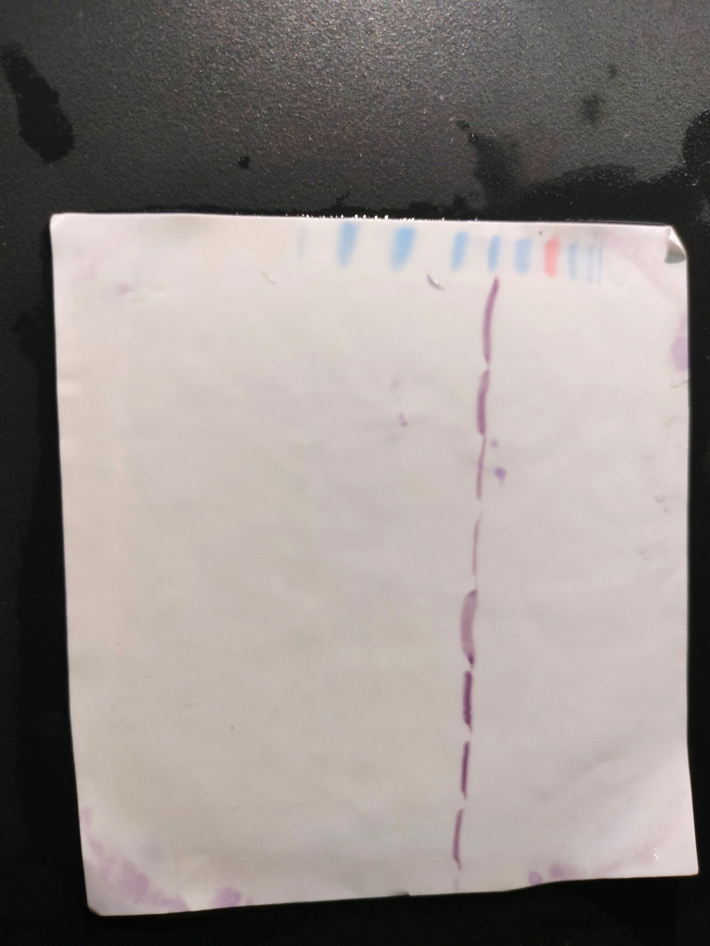
Andrographolide alters protein expression of Cathepsin B at different time intervals.
CON
3h
6h
9h
Gene expression
28 kDa
Cathepsin B
ADG treatment altered Cathepsin B protein expression at different time intervals.

Slide 15
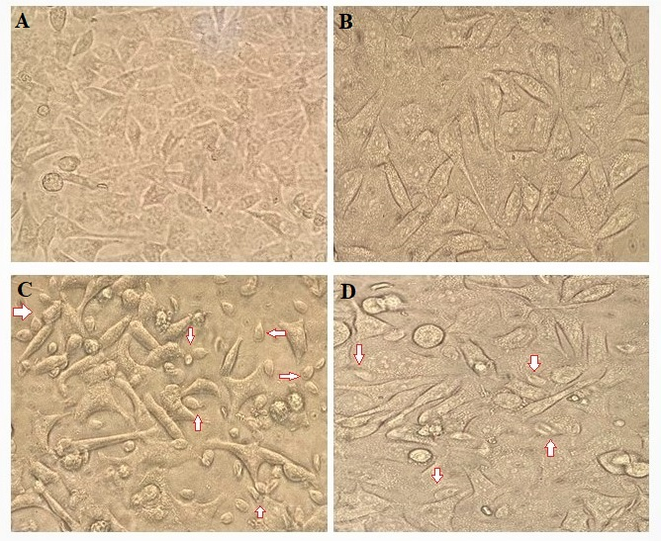
Cytotoxicity assessment of ADG on INT-407 Intestinal cell line
in vitro Effect of ADG on Co-culture. Control (A) ADG treated (B), Giardia and INT-407 Co-culture(C), Co-culture with ADG (D).

Slide 16
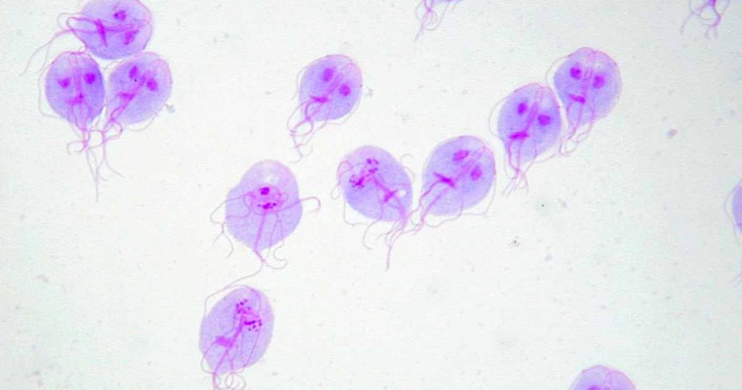

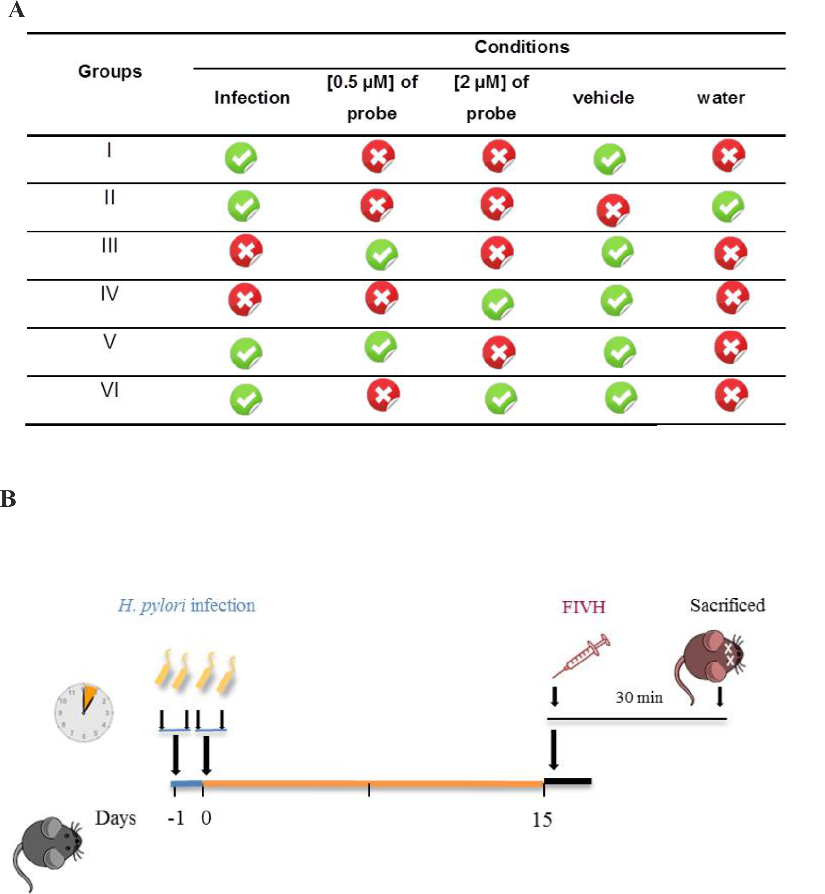
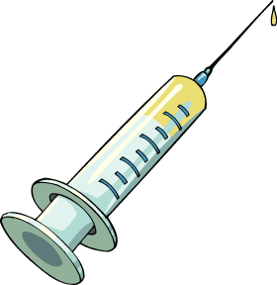

Animal Experiment in flow-chart
ADG therapy, 20mg/kg
Five doses applied once every day.
Mice were sacrificed. Intestinal tissues and stools were collected.
Days:
1 - 14
15
20
Stools collection for PCR and microscopy.
Intestinal tissues for histology.
Mice were orally inoculated by gavaging live Giardia trophozoites suspension (2x10⁶/inoculum) once every day.

Slide 17
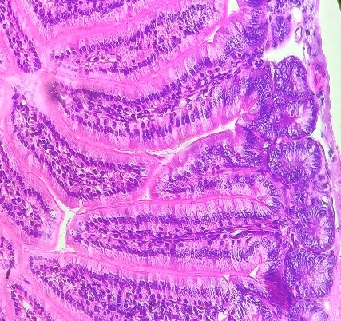
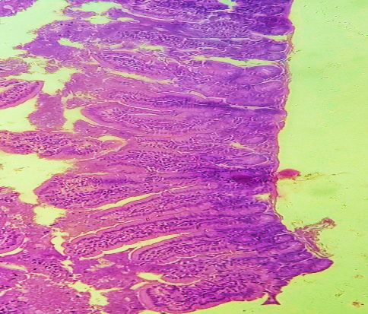
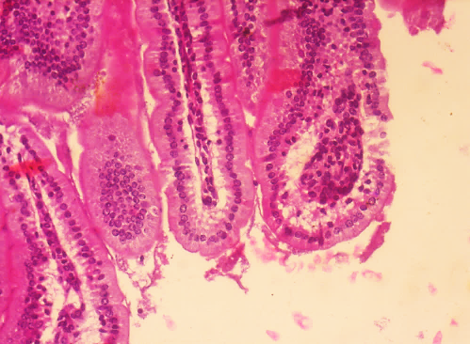
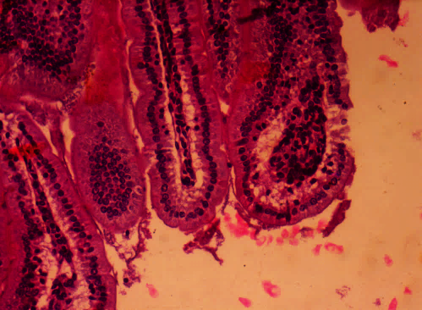
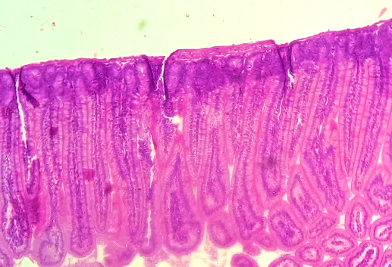
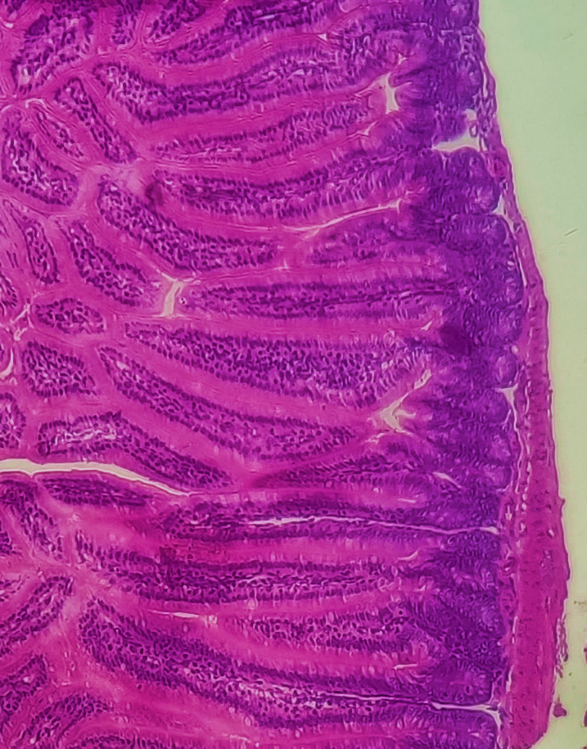
The Therapeutic activity of ADG in mice: Histopathological evaluation and detection of Giardia trophozoites colonization in intestine.
A
B
C
D
H & E staining was used to stain intestinal tissue of control (A), Giardia infection (B) and ADG treated (C&D) mice intestinal tissues.

Slide 18
Conclusion
The significant anti-giardia activity of Andrographis plant extract suggests a new and hopeful direction for the treatment of giardiasis.
The significant anti-giardia effect of andrographolide along with its other promising activities, suggest an innovative idea for the development of drugs against giardiasis.
Andrographolide down-regulates many pathogenic factors at both the transcriptomic and proteomic levels.
The andrographolide demonstrated potent activity against Giardia in vivo model without causing any adverse effects on intestinal cell line. This positive response indicates a potential drug development strategy for the treatment of giardiasis.

Slide 19
Publications
Haldar T, Sardar SK, Ghosal A, Prasad A, Saito-Nakano Y, Dutta S, Nozaki T, Ganguly S (2024). Andrographolide induced cytotoxicity and cell cycle arrest in Giardia trophozoites. Exp Parasitol, 122: 2567-84. https://doi.org/10.1016/j.exppara.2024.108773
Haldar T, Sardar SK, Ghosal A, Das K, Saito-Nakano Y, Dutta S, Nozaki T, Ganguly S (2024). Unveiling the anti- giardial properties of Andrographis paniculata leaf extract through in vitro studies. Tropical Biomedicine 41(3): 319-327. https://doi.org/10.47665/tb.41.3.013
Haldar T, Sardar SK, Ghosal A, Ghosh A, Ganguly S (2025). Andrographolide modulates Giardia gene expression at transcriptomic and proteomic levels. Int. J. of Pharm. Sci. 3(5), 4978-4984. https://doi.org/10.5281/zenodo.15555070
Haldar T, Ganguly S (2025). Molecular cloning and expression of Giardia cathepsin B. Int. J. of Sci. and Res. 14(5), 1564-1567. https://doi.org/10.21275/SR25525095300
Haldar T, Sardar SK, Ghosal A, Ganguly S (2025). Malaria: Biology, Disease and Control-A Comprehensive Overview. Int. J. of Adv. Res. 13(05), 451-456. http://doi.org/10.21474/IJAR01/20920
Sardar SK, Ghosal A, Haldar T, Prasad A, Mal S, Saito-Nakano Y, Kobayashi S, Dutta S, Nozaki T, Ganguly S (2024).Genetic characterization of the Entamoeba moshkovskii population based on different potential genetic markers. Parasitology, 151(4), 429–439. https://doi.org/10.1017/S003118202400026X
Sardar SK, Ghosal A, Haldar T, Maruf M, Das K, Saito-Nakano Y, Kobayashi S, Dutta S, Nozaki T, Ganguly S (2023). Prevalence and molecular characterization of Entamoeba moshkovskii in diarrheal patients from Eastern India. PLoS Negl Trop Dis, 17: e0011287. https://doi.org/10.1371/journal.pntd.0011287
Sardar SK, Goel G, Ghosal A, Deshmukh R, Bhattacharya S, Haldar T, Maruf MM, Mahto R, Kumar J, Bhave SJ, Dutta S, Ganguly S (2023). First case report of Cyclosporiasis from eastern India: Incidence of Cyclospora cayetanensis in a patient with unusual diarrheal symptoms. J Infect Dev Ctries, 17:1037-1040. https://doi.org/10.3855/jidc.17465
Ghosal A, Sardar SK, Haldar T, Maruf M, Saito-Nakano Y, Dutta S, Nozaki T, Ganguly S (2023). Genotyping and epidemiological distribution of diarrhea-causing isolates of Giardia duodenalis in southeastern part of West Bengal, India. Parasitol Res, 122: 2567-2584. https://doi.org/10.1007/s00436-023-07956-7
Sardar SK, Ghosal A, Haldar T, Das K, Saito-Nakano Y, Kobayashi S, Dutta S, Nozaki T, Ganguly S (2023). Investigating genetic polymorphism in E. histolytica isolates with distinct clinical phenotypes. Parasitol Res, 122: 2525-2537. https://doi.org/10.1007/s00436-023-07952-x
Sardar SK, Das K, Maruf M, Haldar T, Saito-Nakano Y, Kobayashi S, Dutta S, Ganguly S (2022) Molecular evidence suggests the occurrence of Entamoeba moshkovskii in pigs with zoonotic potential from eastern India. Folia Parasitol (Praha), 69:2022.012. https://doi.org/10.14411/fp.2022.012
Ghosal A, Sardar SK, Haldar T, Prasad A, Das K, Kobayashi S, Saito-Nakano Y, Dutta S, Nozaki T, Ganguly S (2024). A rapid economical multiplex PCR-RFLP method for molecular detection and genotyping for Giardia duodenalis clinical isolates. Diagn Microbiol Infect Dis, 110:116548. https://doi.org/10.1016/j.diagmicrobio.2024.116548
Sardar SK, Mal S, Ghosal A, Haldar T, Prasad A, Ghosh A, Saito-Nakano Y, Kobayashi S, Dutta S, Nozaki T, Ganguly S (2024). A new multiplex PCR assay reveals the occurrence of E. bangladeshi alonesight E. histolytica and E. moshkivskii in Estern India. Acta Parasit. https://doi.org/10.1007/s11686-024-00921-z
Ghosal A, Sardar SK, Haldar T, Prasad A, Das K, Kobayashi S, Saito-Nakano Y, Dutta S, Nozaki T, Ganguly S (2024). Prevalence of Cyclospora cayetanensis in diarrheal patients in eastern reagion of India. JJID. (Accepted)

Slide 20
